Slide 1
Operating Systems CS2006
Chapter: 4 CPU Scheduling

Slide 2
What’s in today’s lecture
Basic Concepts
Scheduling Criteria
Scheduling Algorithms

Slide 3
Basic Concepts
In multiprogramming systems, where there is more than one process runnable (ready), the OS must decide which one to run next
We already talked about the dispatcher, whose job is to allow the next process to run
It’s intimately associated with a scheduler whose job is to decide (using a scheduling algorithm) which process to have the dispatcher dispatch
We will focus on the scheduling, understand the problems associated with it, and look at some scheduling algorithms

Slide 4
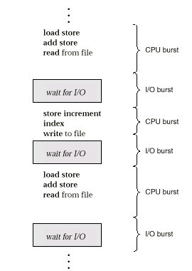
Alternating Sequence of CPU And
I/O Bursts

Slide 5
Nature of Process
Not all processes have an even mix of CPU and I/O usage
A number crunching program may do a lot of computation and minimal I/O
  This is an example of a CPU-BOUND process
A data processing job may do little computation and a lot of I/O
  This is an example of an I/O-BOUND process

Slide 6
Schedulers
Chooses a ready process and activates it
Policy – which process to choose
Choice of policy depends on goals:
  Maximize throughput – avoid idle time and overhead
  Fairness – all jobs get same service
  Minimum average waiting time – good service to some
  Good service to “important” jobs

Slide 7
Schedulers
Short term Scheduler or CPU Scheduling
Long term Scheduler or Job Scheduler
Medium Term Scheduler

Slide 8
Schedulers
Short term Scheduler or CPU Scheduling
  Which program is to be run next
Long term Scheduler or Job Scheduler
  Which ready jobs should be brought to memory
  May need to invoke only when a process leaves the system
  Must make a careful selection

Slide 9
Schedulers
Sometimes OS may swap a blocked process to disk to free up more memory
Or to improve process mix
This is also called Swapping
This scheduler responsible for this task is known as
Intermediate or Medium Term Scheduler

Slide 10
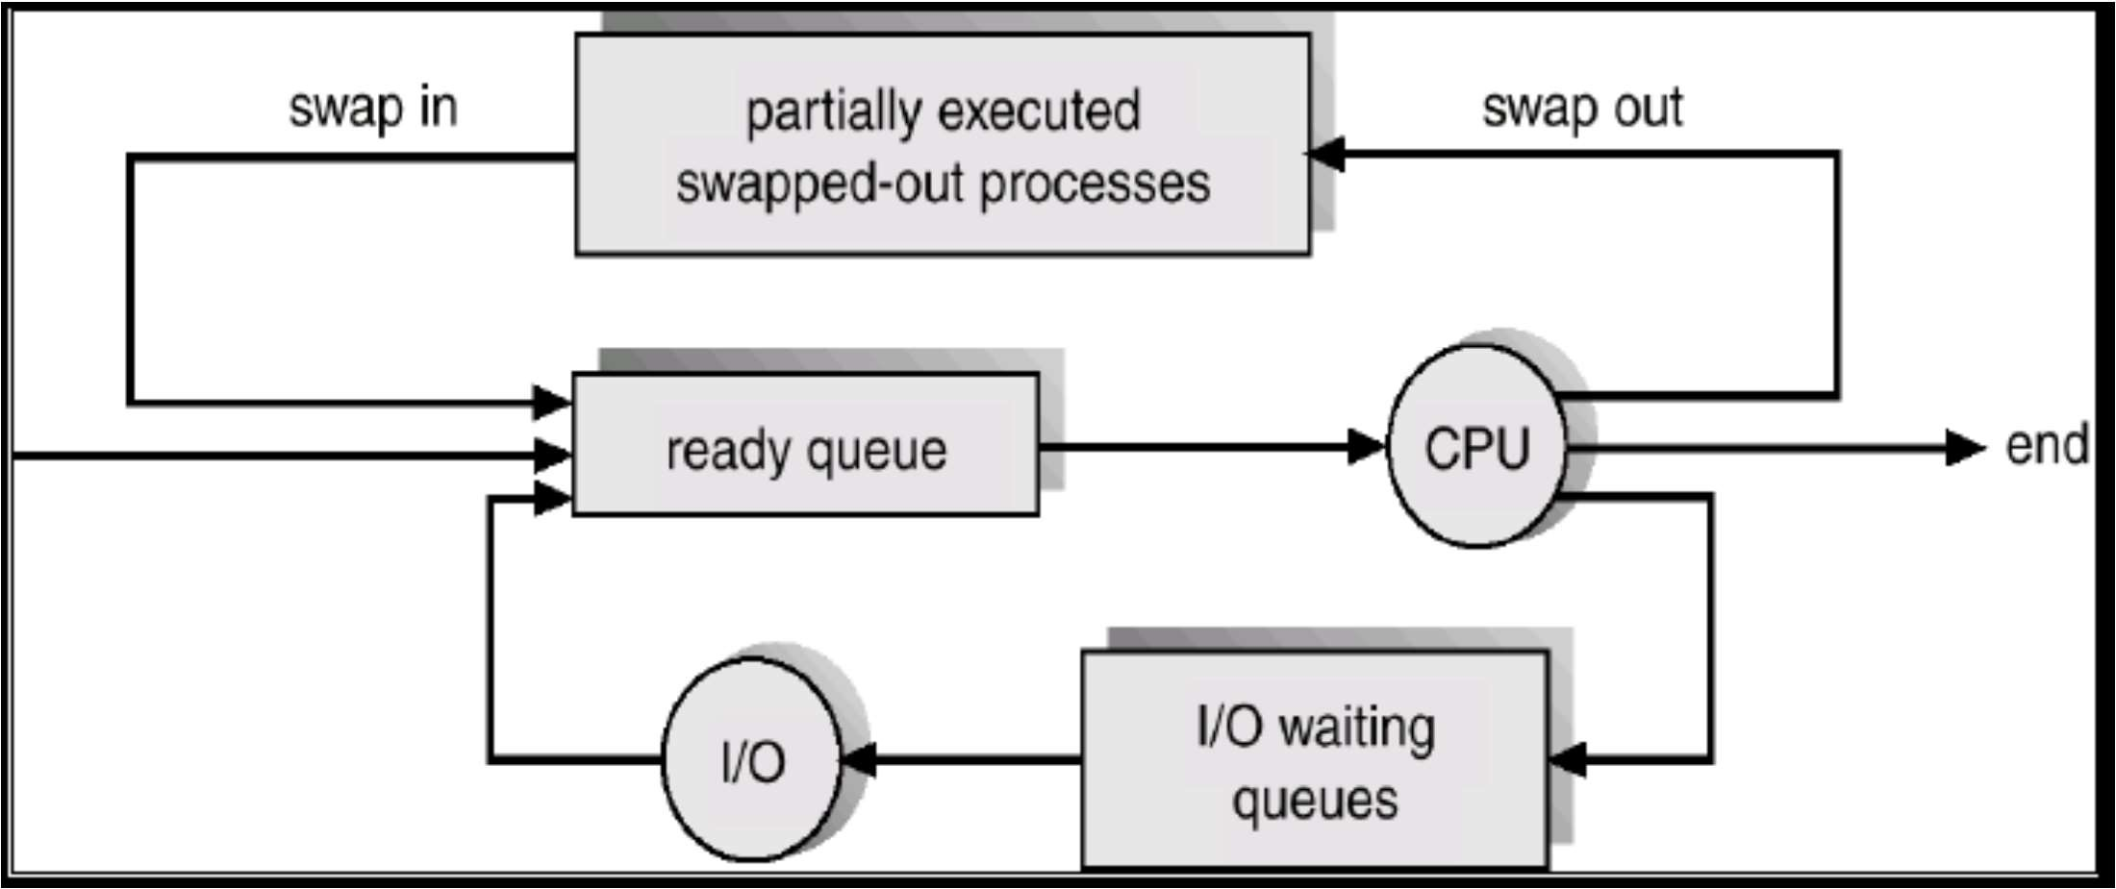
Addition of Medium Term Scheduling

Slide 11
Schedulers (Cont.)
Short-term scheduler is invoked (milliseconds) Design Objective?
Long-term scheduler is invoked (seconds, minutes) (may be slower)
very frequently (must be fast)
very infrequently
 The long-term scheduler controls the degree of
multiprogramming

Slide 12
Scheduling
Short term scheduler (CPU Scheduler)
  Whenever the CPU becomes idle, a process must be selected for execution
  The Process is selected from the Ready queue
Ready queue is not necessarily a FIFO queue
It can be
  Priority based
  A Tree
  Unordered linked list etc
12

Slide 13
Short term Scheduler
Selects from among the processes in memory that are ready to execute, and allocates the CPU to one of them
CPU scheduling decisions may take place when a process:
  Switches from running to waiting state
  Switches from running to ready state
  Switches from waiting to ready
  Terminates
Scheduling under 1 and 4 is nonpreemptive
All other scheduling is preemptive
13
CS-2006 Operating Systems

Slide 14
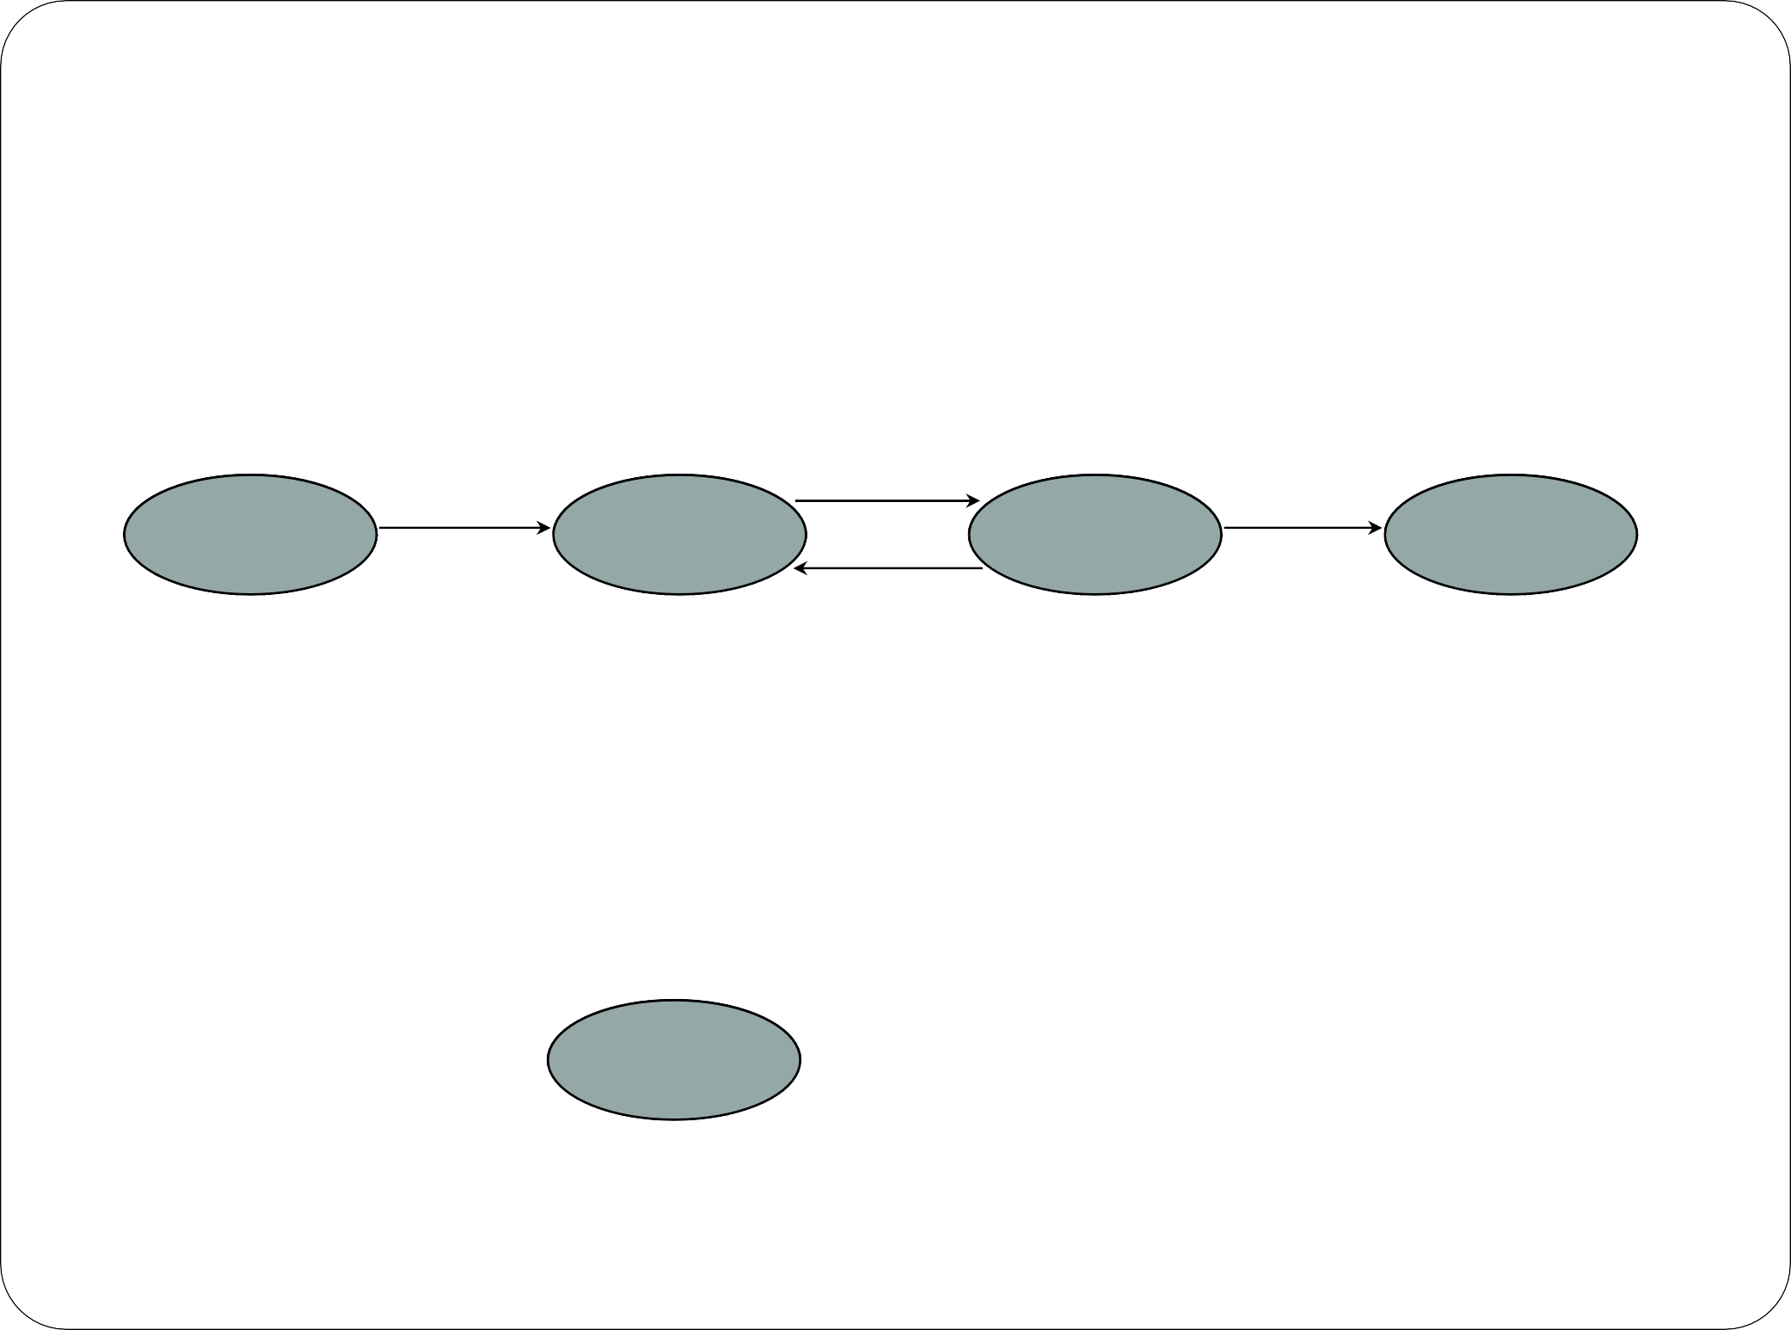
When to select a new process to Run
2. Interrupt occurs,
 Four circumstances
move from Running to Ready
Dispatch
Release
Admit
New
Ready
Running
Exit
Time-out
1. Wait for I/O/
waitpid()/
P()/ Acquire()
etc
_{3. Event I/}E_{O}vent occurs
Completion/ exit(0)
/ V() / Release()
Event wait
Blocked
4. A Process terminates

Slide 15
Non Preemptive Scheduling
Once the CPU has been allocated to a process
The process keeps it until
  It Terminates
  Or has to wait for:
    I/O
    Mutex
    Child process
    Semaphore
    Conditional Variables etc
There is no way, to get the CPU back, FORCEFULLY

Slide 16
Non Preemptive Scheduling
Only the case 1 and 4
Must select a new process, if any, from the Ready Queue
Dispatch
Release
Admit
New
Ready
Running
Exit
Time-out
1. Wait for I/O/
waitpid()/
P()/ Acquire()
etc
Event occurs
Event wait
Blocked
4. A Process terminates

Slide 17
Preemptive Scheduling
 Possible to get the CPU back from a process, even if the process has not completed its execution.

Slide 18
Preemptive Scheduling
2. Interrupt occurs, move from Running to
Ready
Dispatch
Release
Admit
New
Ready
Running
Exit
Time-out
In case of 2 and 3, there is a choice
Whether to continue, with the same process
or select a new one from the ready queue
_{3. Event I/}E_{O}vent occurs
Completion/ exit(0)
/ V() / Release()
Eve
nt wait
Blocked

Slide 19
Dispatcher
Dispatcher module gives control of the CPU to the process selected by the short-term scheduler; this involves:
  Switching context
  Switching to user mode
  Jumping to the proper location in the user program to restart that program
Dispatch latency – time it takes for the dispatcher to stop one process and start another running
19

Slide 20
Scheduling Criteria
CPU Utilization
  Keep the CPU as busy as is possible
  May range from 0% to 100%
Throughput
  Number of processes completed per unit time
  E.g. long processes
    1 process / hr
  Short processes
    10 processes / hr
20

Slide 21
Scheduling Criteria
 Turnaround Time
 How long it take to execute a Process
Turnaround = Completion_Time
– Submission_Time
Turnaround = Wait_Time_{GetIntoMemory}
+ Wait_Time_{ReadyQueue}
+ Wait_Time_{BlockQueue}
+ CPU_Execution_Time

Slide 22
Scheduling Criteria
Scheduling Algorithm does not effect the waiting time in Block Queue
It only effect the Waiting Time in the Ready Queue
Waiting Time
 Sum of the periods spent waiting in the Ready Queue
W.T = Finish Time –Burst Time –Arrival Time

Slide 23
Scheduling Criteria
Turnaround Time is not a good criteria for Interactive Systems
A process may
  Produce “Some” output
  Computes new results, while previous results are output to the user
Response Time
Response_Time = First_Response_Start_Time
– Submission_Time
23
CS-2006 Operating Systems

Slide 24
Additional Scheduling Criteria
There are also other elements to consider:
  Priority/Importance of work – hopefully more important work can be done first
  Fairness – hopefully eventually everybody is served
 Implement policies to increase priority as we wait longer… (this is known as “priority aging”)
  Deadlines – some processes may have hard or soft deadlines that must be met
  Consistency and/or predictability may be a factor as well, especially in interactive systems

Slide 25
Optimization Criteria
We would like to Maximize
  CPU Utilization
  Throughput
And Minimize
  Turnaround Time
  Waiting Time
  Response Time

Slide 26
Scheduling Algorithms
First come, First serve (FCFS)
Shortest Job First (SJF)
Priority Scheduling
Round-Robin Scheduling
Multi-level Queue Scheduling
Multi-level Feed back queue Scheduling

Slide 27
1. First-Come, First-Served (FCFS) Scheduling
Simplest scheduling algorithm:
  Run jobs in order that they arrive
Uni-programming:
  Run until done
Multi-programming:
  Run until done or Blocks on I/O
Nonpreemptive
  A Process keeps CPU until done or I/O
Advantage:
  Simplicity
27
CS-2006 Operating Systems

Slide 28
FCFS Scheduling
Process | Burst Time
P₁ | 24
P₂ | 3
P₃ | 3
 Suppose that the processes arrive in the order: P₁ , P₂ , P₃
The Gantt Chart for the schedule is:
P₁ | P₂ | P₃
0 24 27
Waiting time for P₁ = 0; P₂ = 24; P₃ = 27
Average waiting time: (0 + 24 + 27)/3 = 17
30
28

Slide 29
FCFS Scheduling (Cont.)
▪ Suppose that the processes arrive in the order P₂ , P₃ , P₁
 The Gantt chart for the schedule is:
P₂ | P₃ | P₁
0 3 6
Waiting time for P₁ = 6;P₂ = 0; P₃ = 3
Average waiting time: (6 + 0 + 3)/3 = 3
Much better than previous case
30
29

Slide 30
Convoy Effect
process service turnaround waiting time t_{s} time t_{t} time t_{w}
A 10 10 0
B 1 11 10
C 3 14 11
D 4 18 14
AVERAGE 13.25 8.75
A long CPU-bound job may hog the CPU and force shorter (or
process
A B C D
10
1
I/O-bound) jobs to wait for
prolonged periods. This in turn may lead to a lengthy queue of
3
4
ready jobs, and hence to the
'convoy effect'
5
10
15
20
25
time
30

Slide 31
FCFS Scheduling (Cont.)
FCFS is:
  Non-preemptive
  Ready queue is a FIFO queue
  Jobs arriving are placed at the end of ready queue
  First job in ready queue runs to completion of CPU burst
Advantages: simple, low overhead
Disadvantages: long waiting time, inappropriate for interactive systems, large fluctuations in average turnaround time are possible
31

Slide 32
References
 Operating System Concepts (Silberschatz, 9th edition) Chapter 5
32

